Slide 1

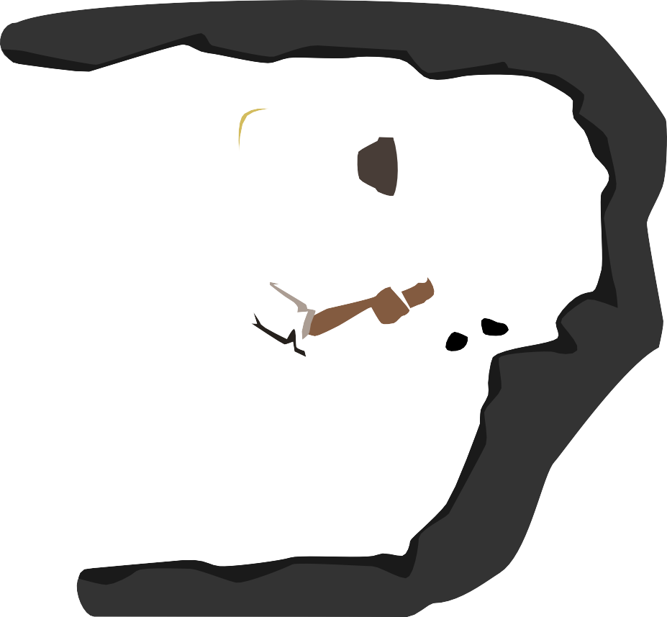

Matson Social Skills
Seyed Ehsan Sajadi Kian Jalilian Kamyab Abedi
DataMining Course - Spring 1400

Slide 2
TABLE OF CONTENTS
Introduction
Briefly elaborate on what we want to discuss.
PROBLEM & SOLUTION
Review on our datasets
OUR PROCESS
What we did?
TARGET
What is our target?

Slide 3
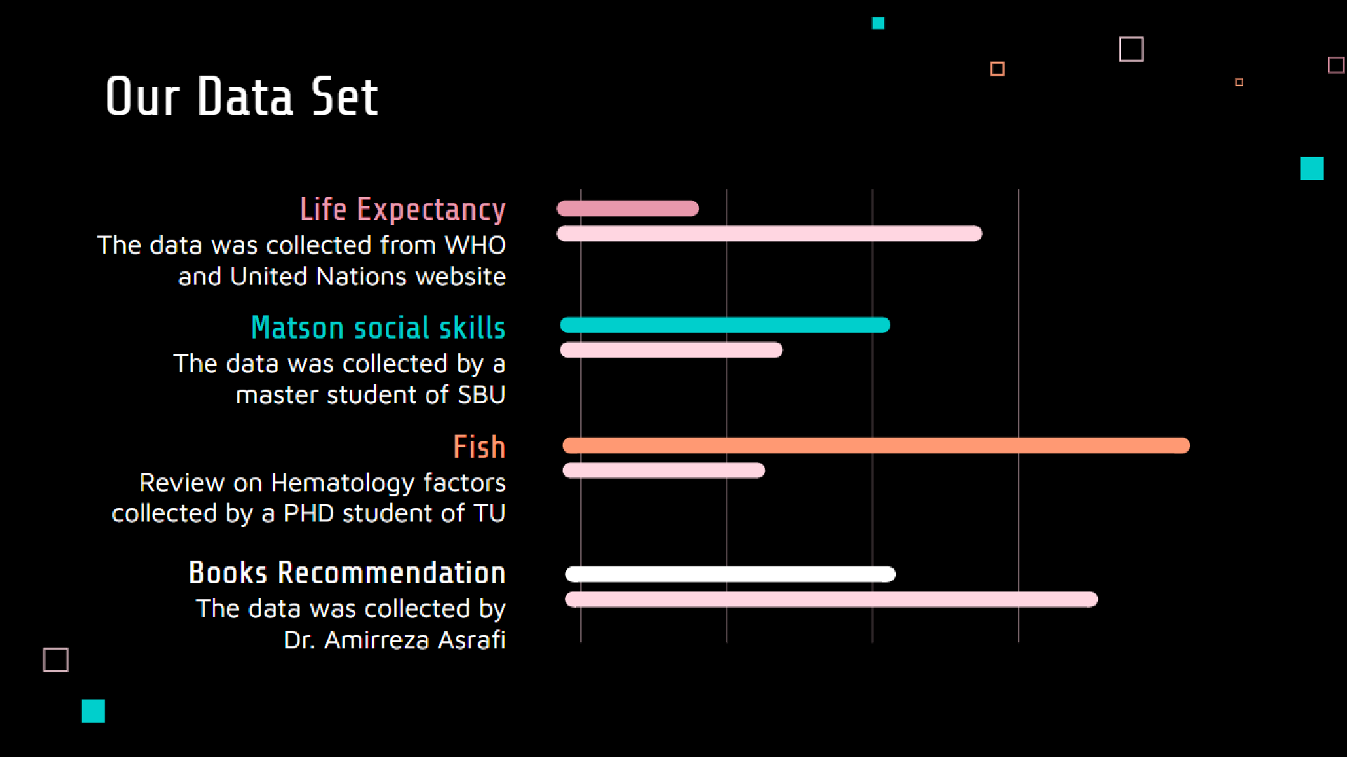

Slide 4
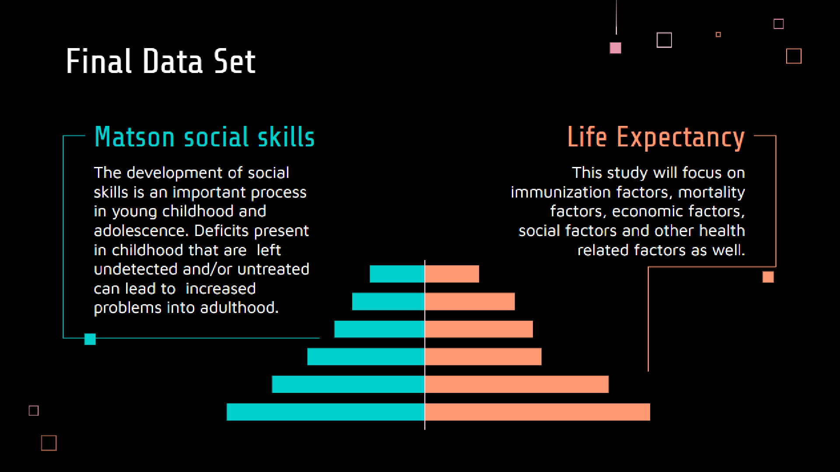

Slide 5


Matson social Skills
160 row
Contain 80 men and women
135 column
Collected by surveys
Final data set
Briefly elaborate on what you want to discuss.

Slide 6
OUR PROCESS

Slide 7
1. Data Collection
The process of gathering information from different sources

Slide 8

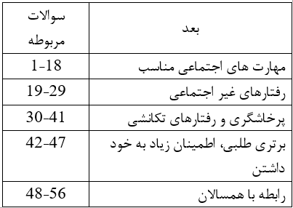
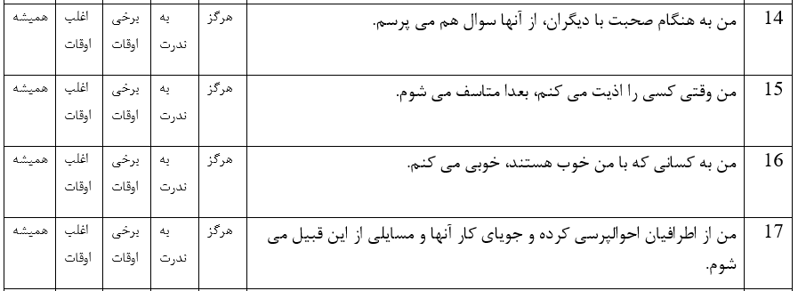
2. Data Profiling
The process of reviewing source data for content and quality

Slide 9
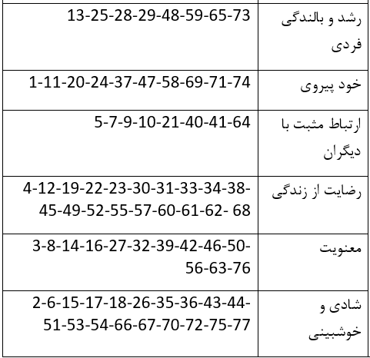
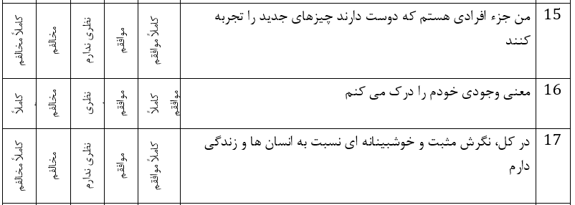
بهزیستی روانشاختی

Slide 10

3. Data Exploration
A visual exploration to help users familiariza with information

Slide 14
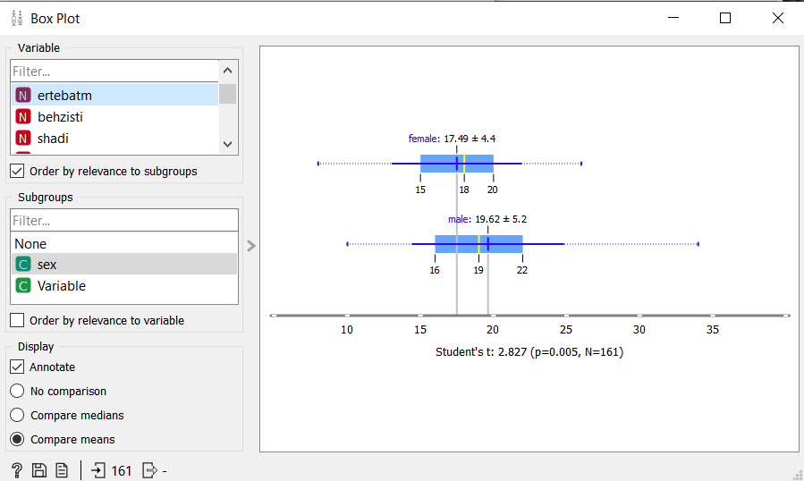

Slide 15
4. Pre-Processing
It include feature engineering, management of missing values and outliers, data normalization, etc.

Slide 16
OUR TARGET

Slide 17
in progress

Slide 18
Do you have any questions?
THANKS

